Slide 1
LEAD SCORING CASE STUDY
group members
Rajdeep singh
Rinsha p
Ritu pareek

Slide 2
Problem statement
An education company named X Education sells online courses to industry professionals.
The company markets its courses on several websites and search engines like Google. Once these people land on the website, they might browse the courses or fill up a form for the course or watch some videos. When these people fill up a form providing their email address or phone number, they are classified to be a lead.
some of the leads get converted while most do not. The typical lead conversion rate at X education is around 30%.
To make this process more efficient, the company wishes to identify the most potential leads, also known as ‘Hot Leads’.
If they successfully identify this ‘Hot Leads’, the lead conversion rate should go up as the sales team will now be focusing more on communicating with the potential leads rather than making calls to everyone.

Slide 3
Goals of the Case Study
Build a logistic regression model to assign a lead score between 0 and 100 to each of the leads which can be used by the company to target potential leads.
Model should be able to adjust to if the company's requirement changes in the future.

Slide 4
steps
Data set understanding and cleaning
Handling missing values
Data analysis(EDA)
Univariate Analysis
Bivariate Analysis
Preparing data for modelling
Dummy variables
Test-train split
Feature scaling
Model Building
Model Evaluation
Predictions
Model validation
Conclusion/Recommendations

Slide 5
Data set understanding and cleaning
9240 rows and 37 columns.
Data cleaning and handling missing values.
Few columns showing 'Select'. These values are as good as missing values and hence it will convert 'Select' values to Nan, replacing 'Select' values with Nan.
Dropping columns having missing value percentages greater than or equal to 35%.
Dropping Prospect ID and Lead Number columns because they are irrelevant information or variables for data analysis.
Dropping unique valued columns.
Imputing columns having missing value percentages more than 20% .
Dropping the rows with remaining missing data.

Slide 6
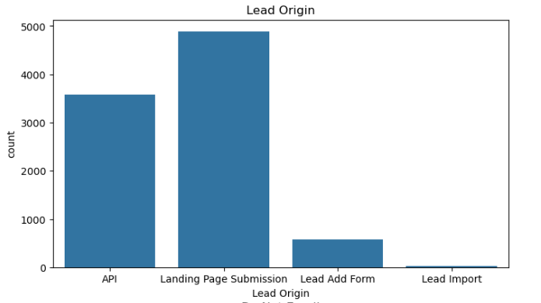
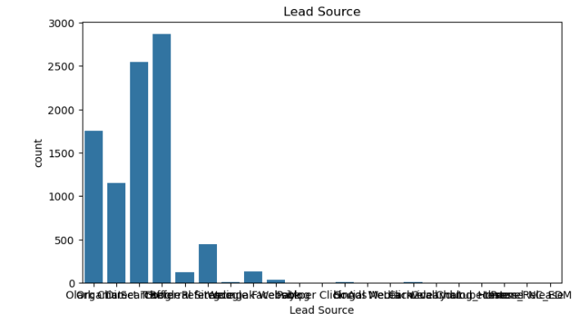
Exploratory data analysis
Univariate Analysis:
visualizing categorical variables using count plot

Slide 7
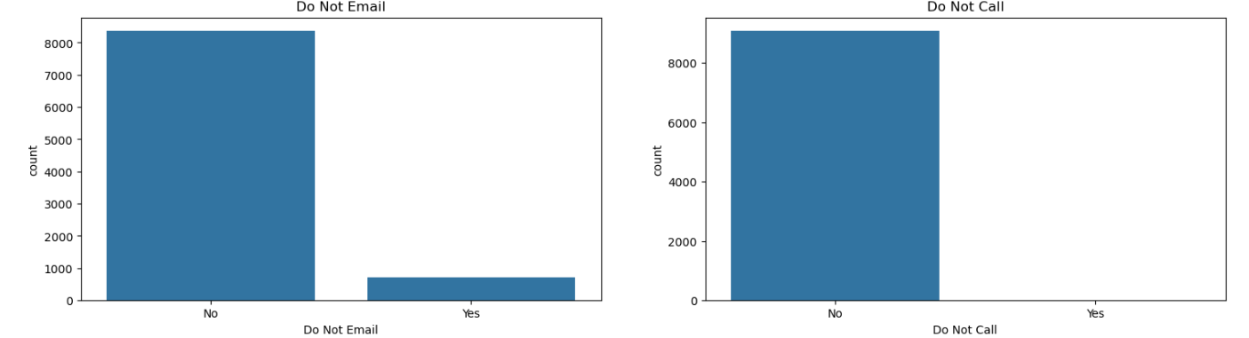
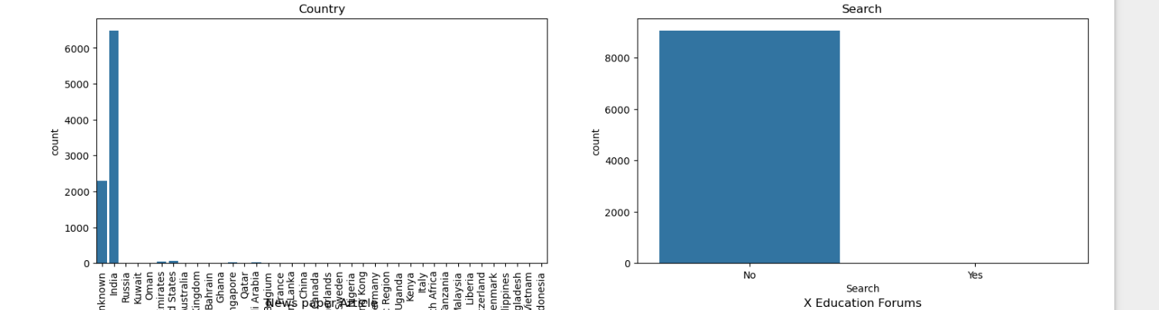

Slide 8
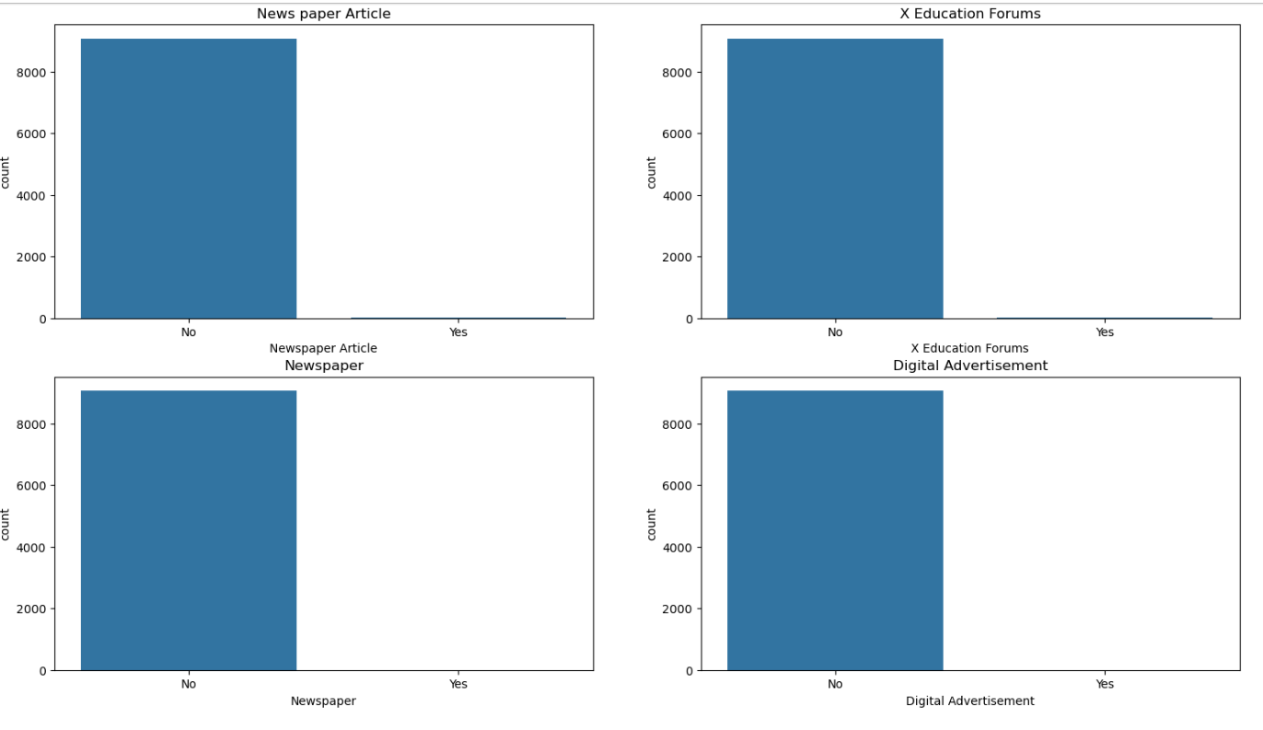

Slide 9
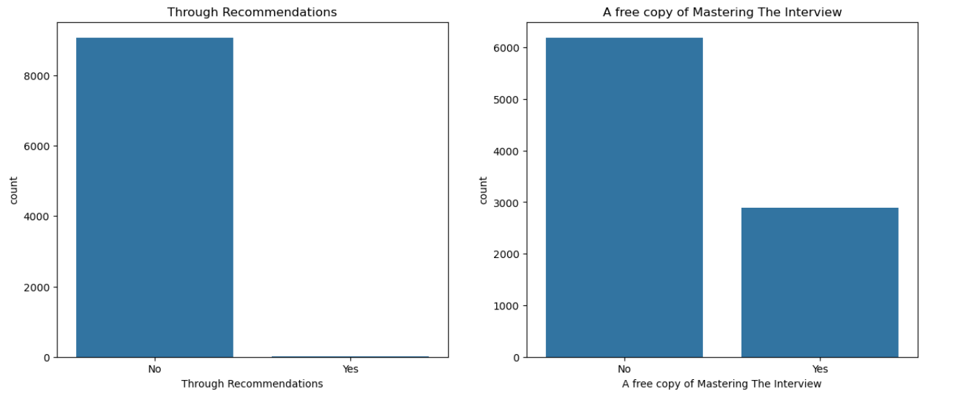
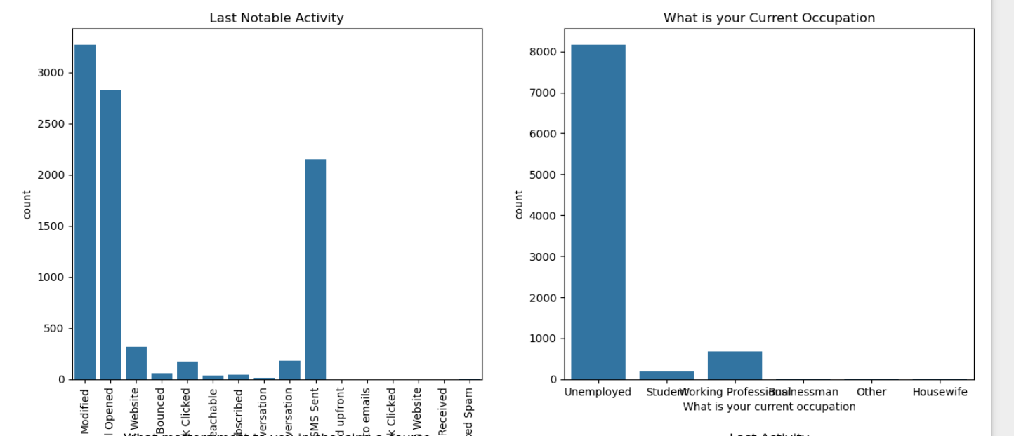

Slide 10
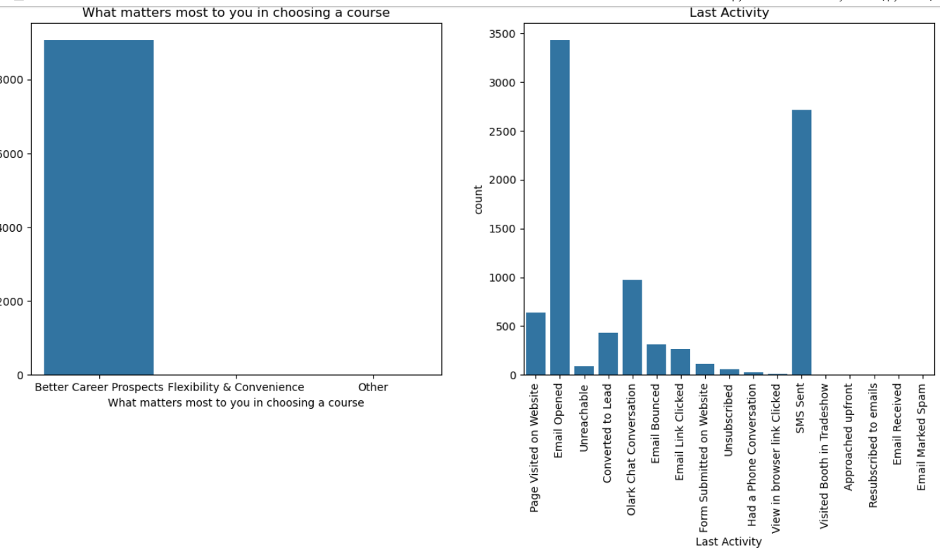

Slide 11
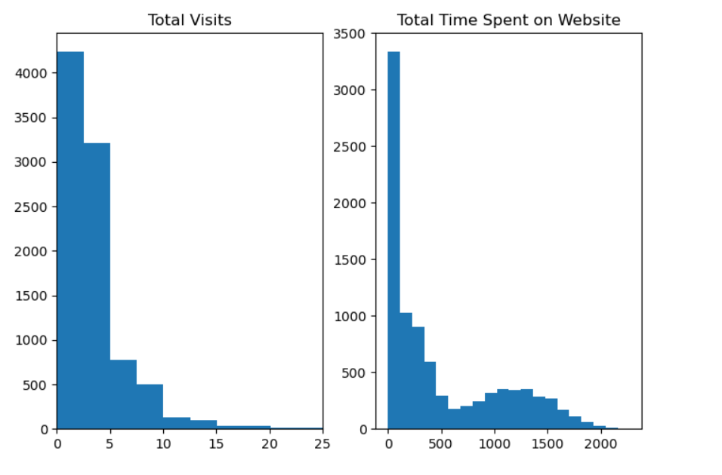
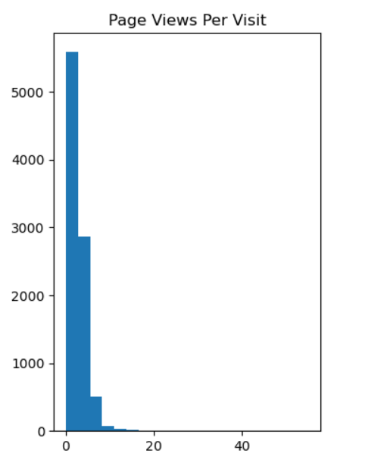
visualizing numerical variables using histogram plot

Slide 12
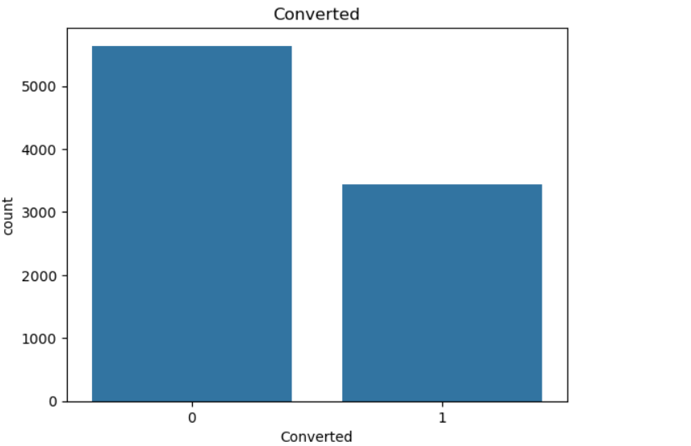
visualizing converted (Target Variable)column using count plot
Insight: Around 5600 people haven't join any course whereas more than 3000 people have got converted to leads by joining any course from X education.

Slide 13
Bivariate Analysis:
Categorical_Target Variable Analysis
visualizing the relationship between categorical variables and target variable " converted" using count plot

Slide 14
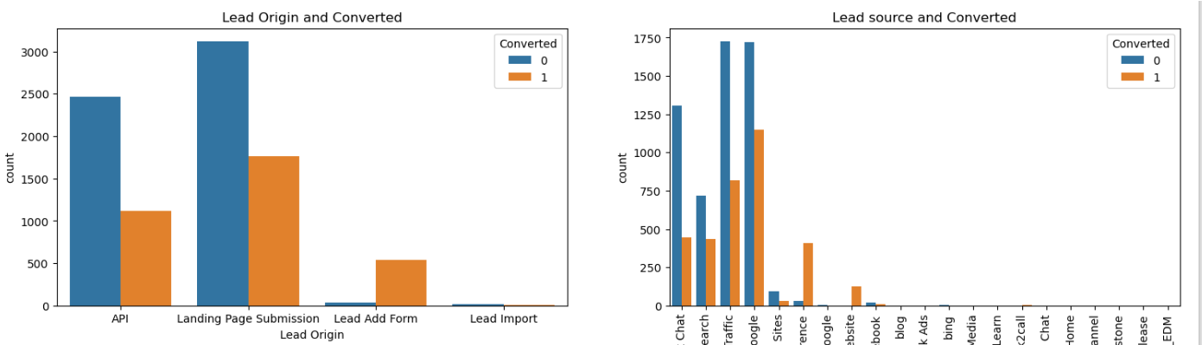
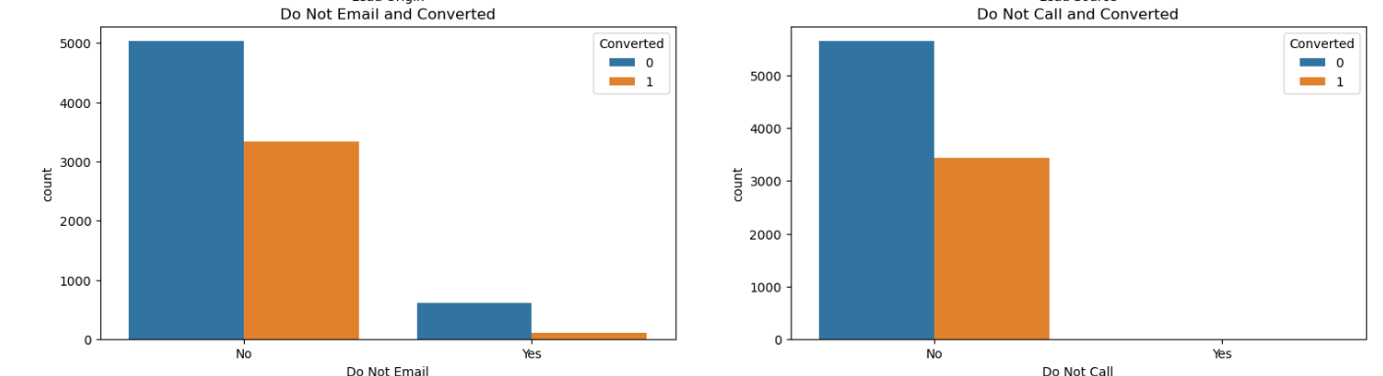

Slide 15
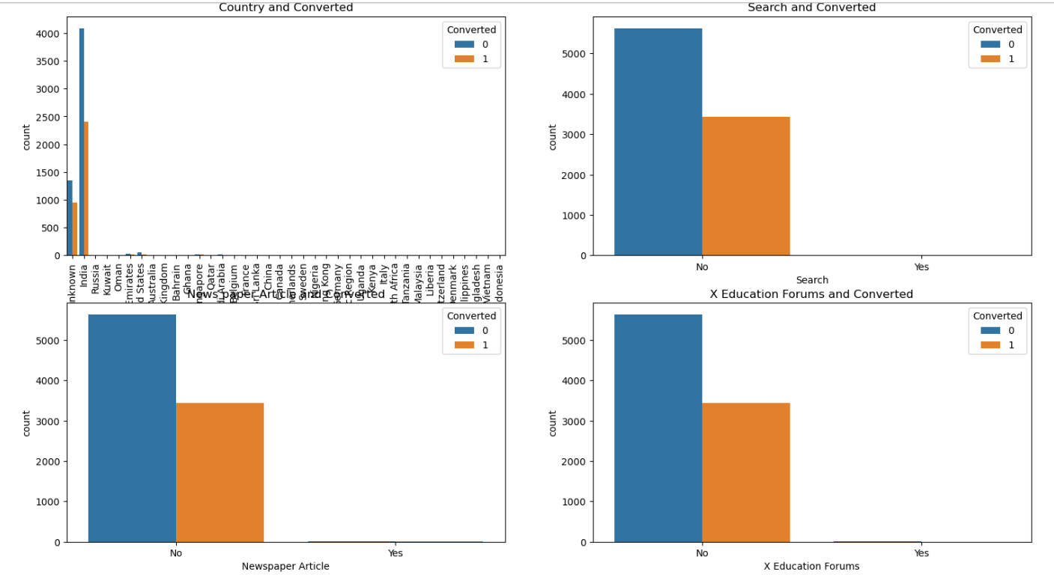

Slide 16
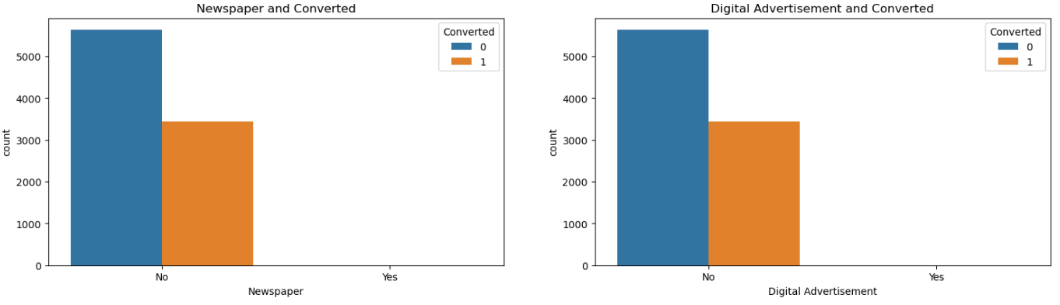
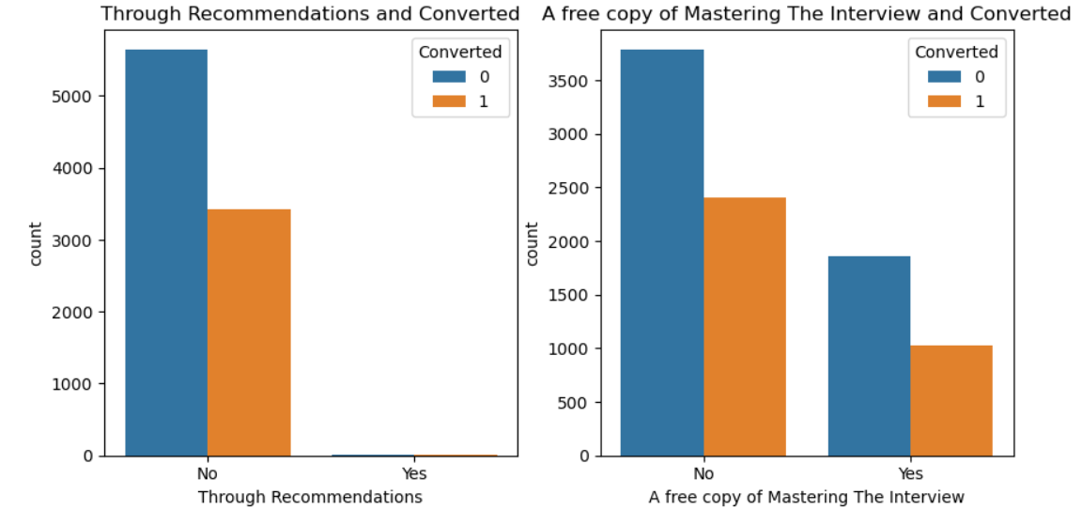

Slide 17
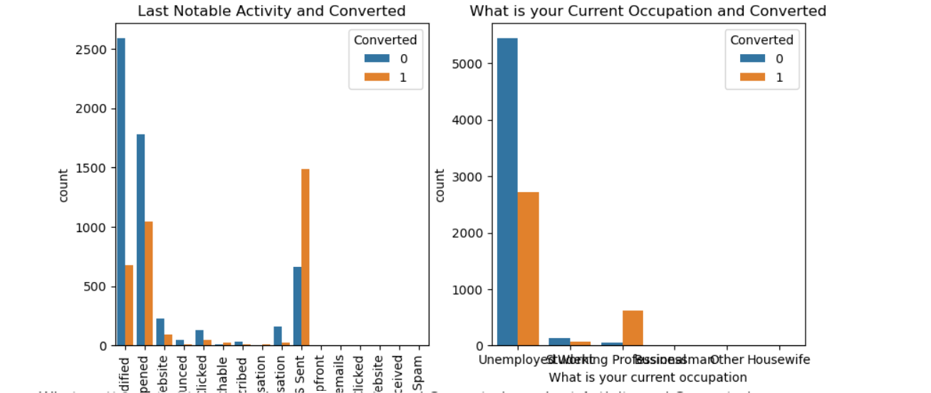
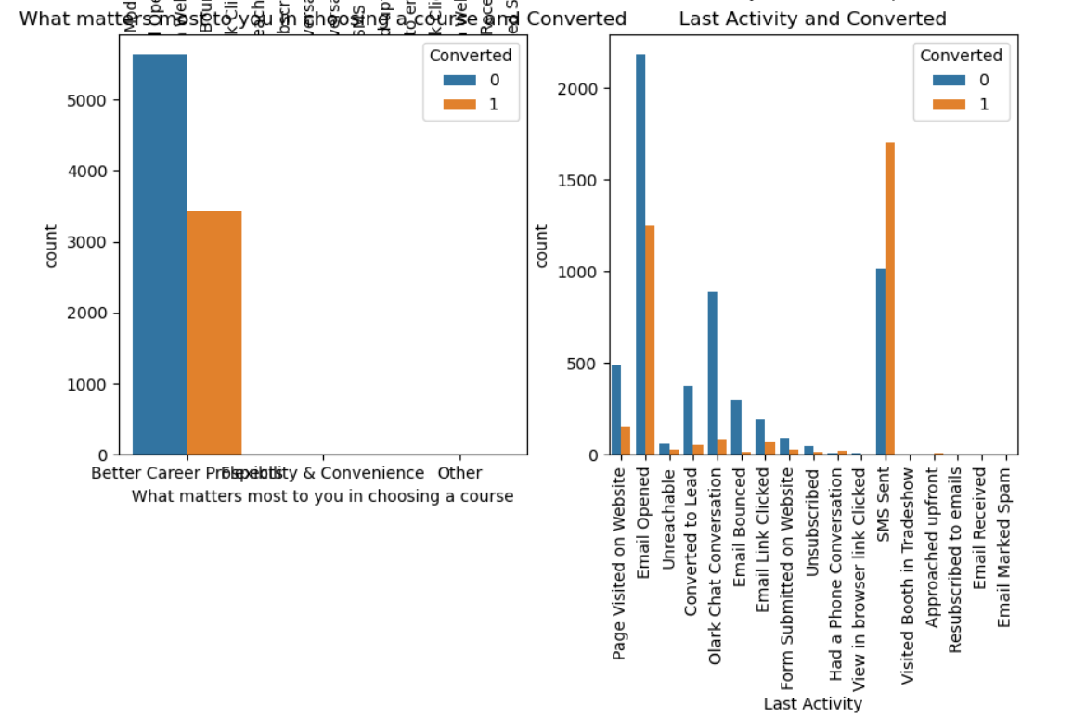

Slide 18
Insights
In lead origin Landing Page Submission has highest count of people who didn't convert but at the same time a good count of people had converted.
In lead origin Lead Added form total count less but in that count most of the people converted .
From Lead source count plot we can see that most converting people are from Google.
do not email and do not call people are showing highest conversion count .
In cities India has highest conversion count.
In search analyzing People who didn't search about the courses are mostly converted.
good conversion rate for People who haven't seen ads on Newspaper Articles , X Education Forum , Newspaper and Digital Advertisement .

Slide 19
A good conversion rate for the customer didn't came in through recommendations.
The customer didn't want a free copy of 'Mastering the Interview' has the highest count of conversion also the customer wants the copy showing a conversion but in less count rate.
In last notable activity performed by the student ,Sms Sent have highest conversion count and modified is the highest not converted category.
In current occupation ,Working profession shows highest count of conversion also unemployed people have higher rate of conversion.
what is their main motto behind doing this course is Better Career Prospects shows highest conversion.
In Last activity performed by the customer, Sms Sent have highest conversion count also email opened have a good conversion rate.

Slide 20
Preparing data for modelling
Creating dummy variables and dropping a redundant dummy variables.
Test-Train Split
Data set divided into test and train with proportion of 70-30%.
Feature Scaling
Minimax scale is used for scaling numerical variables.
checked the correlation among variables using heatmap(it is difficult to analyse and drop variables due to lot of variables.).

Slide 21
Model Building
Imported the 'Logistic Regression' and creating a Logistic Regression object.
Used Recursive Feature Elimination for feature selection.

